Slide 1

Bayesian Network in Nutritional Epidemiology
Analysis of the relationships between dietary patterns, breast cancer and confounders
Morales Emanuele - 941935
Notes:
My project consists in the application of Bayesian Network in Nutritional Epidemiology, in order to study the relationships between the variables related to dietary pattern of patients and the cancer outcome. This idea of project starts from a laboratory of nutritional epidemiology that I attended in this quarter.

Slide 2


Goal of the project and steps
Goal of the project:
Implementation of a BN network on breast cancer dataset to determine and visualize interactions between variables (confounding) and to estimate conditional probability.
Steps:
1. Structure learning procedure;
2. Model validation;
3. Queries on the network.
Notes:
So the goal is to obtain a flexible tool that allows to visualize and determine the relationship between the variables involved in the study and the cancer outcome, paying particular attention also to the confounding variables (that are related both to the cancer both to the dietary variables). Standard approach, as I studied in lab, starts from a logistic regression in order to determine the correlation between variables, instead this method allows to make some queries exploiting conditional probability.
The project is divided in three main parts:

Slide 3
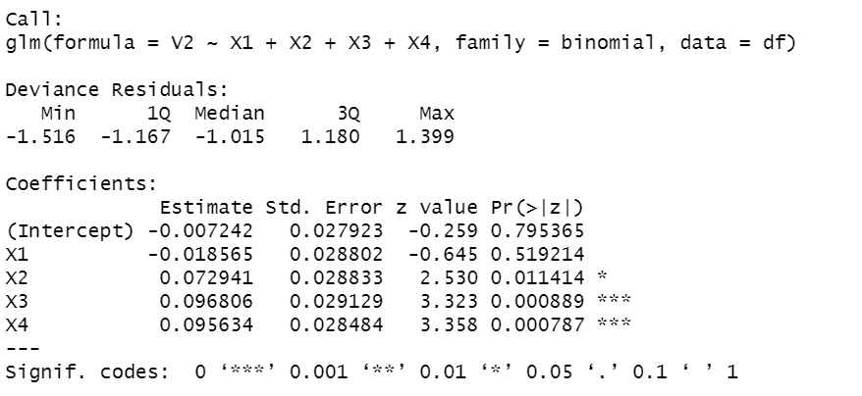
Dataset
Dataset is composed by categorical variables about 5157 patients:
Patient’s information: Age, Education, Number of pregnancies
Medical Information: Menopausal Status, BMI
Patient’s habits: Smoking status, Alcohol intake, Physical activity
Dietary Pattern: X2, X3, X4
Cancer Outcome: V2
So far, the following correlations have been found:
Correlation between dietary patterns and cancer;
Menopausal Status, num. of pregnancies, smoking status, alcohol status and physical activity are confounding variables.
Notes:
The dataset is composed by data retrieved on interviews performed on 5157 patients and the variables involved are:
Dietary pattern:
X2: adherence to a diet with high sugar and low vegetable fats consume:
X3: High starch and low animal product
X4: High sodium and low beta-carotene.
As I said this project starts from a previous analysis where we found the correlation between the diets and the cancer and some confounding factors by applying logistic analysis.

Slide 4
Structure Learning: an hybrid approach
Structure learning algorithms:
Exploit the combination of the main learning procedures to obtain new relationships between variables.
Expert knowledge information:
Exploit previous studies to build the network
(whitelist).
Structure learning algorithms applied:
Constraint-based: PC, Grow – Shrink.
Score-based: Hill-climbing, Tabu greedy search.
Hybrid structure learning: Max-Min hill climbing
Notes:
Constraint-based: identify conditional independence constraint with statistical tests and link nodes that are not found to be independent (loog-likleiohood ratio test)
Score-based: each candidate DAG is assigned a network score optimize as the objective function (bic criterion)
Hybrid: use a restrict phase for implementing constraint-based strategy to reduce the space of candidate DAGs and a maximise phase implementing a score-abased strategy to find optimal DAG in the restricted space.

Slide 5
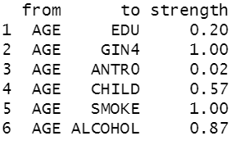
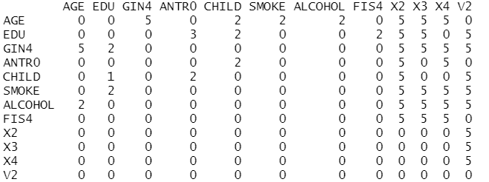
Bootstrap and arcs selection
Data are bootstrapped (n = 100).
For each bootstrap sample a network is learned.
The arcs that have a frequency greater than 0.5 are included in the network in output from the procedure.
For each learning procedure, the adjacent matrix is obtained.
The resulting five adjacent matrix are summed.
Notes:
The process I used is the following:
for each structure learning procedure I bootstrap data (100 sample) and applied the str. Learning algo and obtaining 100 network for each procedure.
Then I observed the strength of the arcs (the frequency of appearance in these 100 models) and I set a threshold of strength. (0.5)

Slide 6
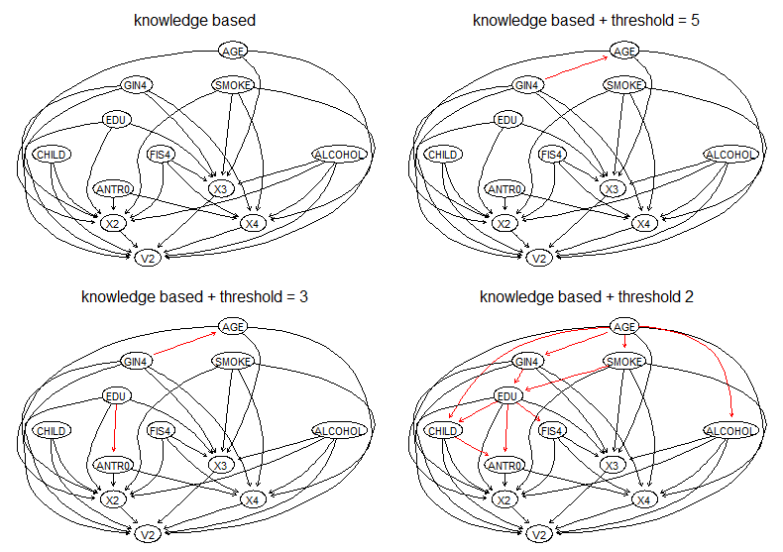
Evaluation of the model
Notes:
The procedure

Slide 7
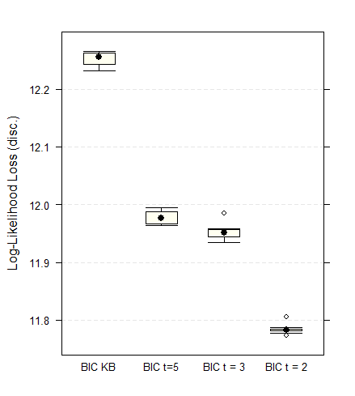
Evaluation of the model: goodness of fit
Increasing the number of arcs:
Pro: higher predictive accuracy.
Cons: higher complexity in interpreting the network.
Notes:
CROSS VALIDATION (10 folds)

Slide 8
Queries on the network
It has been obtained a flexible model that allows to study how the probability of getting breast cancer varies by varying dietary pattern, confounding factors and other variables.
It is possible to make “stratified queries” based on conditional probabilities.

Slide 9
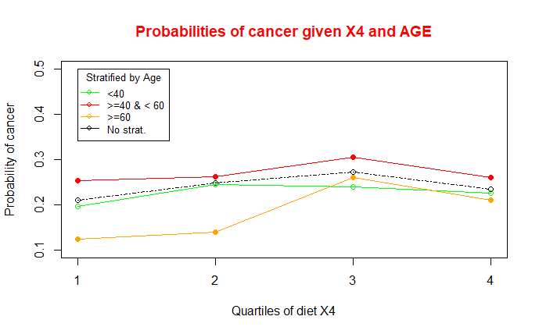
Queries on the network
In literature it can be found that:
“β-carotene [X4] , were inversely associated with the risk […] breast cancer ”
Carotenoid intakes and risk of breast cancer defined by estrogen receptor and progesterone receptor status: a pooled analysis of 18 prospective cohort studies– Zhang, X. et al.
Notes:
Feedback in the literature

Slide 10
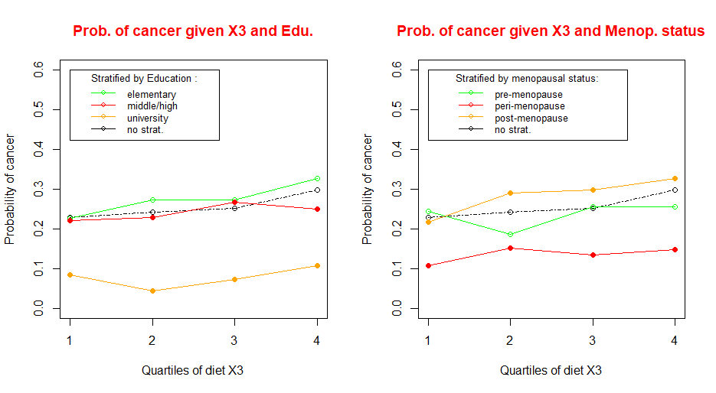
Queries on the network
In literature it can be found that:
“Starch-rich dietary pattern [X3] are directly associated with breast cancer”
Nutrient dietary patterns and the risk of breast and ovarian cancer – Edefonti, V. et al.

Slide 11
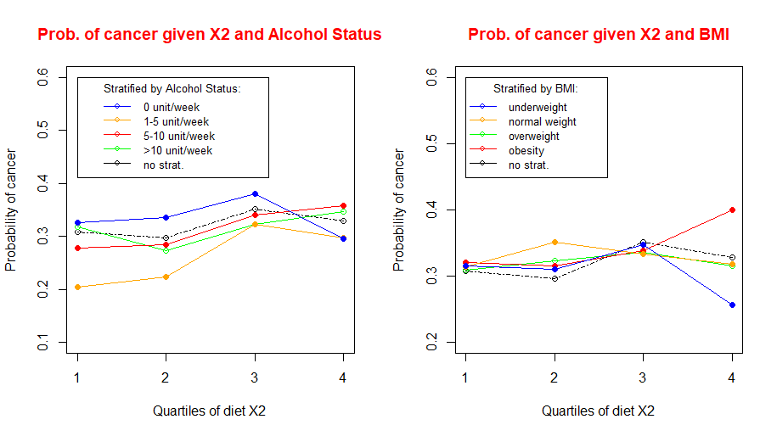
Queries on the network
In literature it can be found that:
“Obesity increases the risk of developing breast cancer […]. Poor dietary habits characterized by the high intake of refined starches […] appear to be linked to increased risk of breast cancer”.
Obesity, Dietary Factors, Nutrition, and Breast Cancer Risk– Seiler, A. et al.

